Slide 1

Bayesian time-series forecasting: prophet
GB Non-domestic Power Demand

Slide 2
Time-Series Forecasting
Models | Details | Examples
ARIMA-based | Autoregressive (AR) terms {values}, differencing to achieve stationarity (I), and moving average (MA) terms {residuals}. | SARIMA, SARIMAX, GARCH, etc.
Decomposition-based | Deconstruction of time series into components: Trend, Seasonalities, Regressors, Residuals. | Prophet
Neural Networks | Use of Transformers, Recurrent Neural Networks (RNN), Convolutional Neural Networks (CNN) | Long Short-Term Memory (LSTM), Temporal Convolutional Networks (TCN)
Ensemble methods | Combines forecasts from multiple models to improve accuracy. | Mix
*Very new: Foundation Models
Notes:
ARIMA-based: Explainability and very good for non-seasonal data >> although no non-linearities.
Evolves in time, all forecasted points depend on the previous points.
Decomposition-based: Good for understanding of the components and time-series that have seasonalities – therefore: affected by patterns (humans, plants, animals) >> Non-linearities for seasonality.
Neural Networks:
Transformers use self-attention to capture relationships between all time points simultaneously, handling long-term dependencies well in time-series forecasting.
RNNs process time-series data sequentially, using past information to predict future values, effective for capturing short to medium-term dependencies.
CNNs apply filters to time-series data to detect local patterns and trends, useful for extracting features and short-term dependencies in forecasting.
Transformers
1. Mechanism: Use self-attention to process all time points simultaneously.
2. Strength: Excellent at capturing long-term dependencies.
3. Efficiency: Can handle very long sequences efficiently due to parallel processing.
4. Complexity: Generally more complex and resource-intensive.
Recurrent Neural Networks (RNNs)
1. Mechanism: Process sequences sequentially, passing information from one step to the next.
2. Strength: Good at handling sequential data with short to medium-term dependencies.
3. Efficiency: Can struggle with long sequences due to issues like vanishing gradients.
4. Complexity: Simpler than transformers, but can become complex with layers like LSTM or GRU for improved long-term dependency handling.
Convolutional Neural Networks (CNNs)
1. Mechanism: Apply filters to detect local patterns and features.
2. Strength: Effective at capturing short-term dependencies and local trends.
3. Efficiency: Efficient at processing data in parallel, but mainly captures local context.
4. Complexity: Less complex than transformers, relatively straightforward to implement.

Slide 3
Why Prophet? in Power Demand Forecasting
Open-box: Clear input components, parameters, outputs, and optimization algorithms. Not a neural network-based model (i.e., less explainable).
Trend, Daily/Weekly/Yearly Seasonality, Holidays, External regressors...
Weights, values of components are part of the output.
Uses “non-linear” algorithms for seasonality– although it is optimized as a linear model (Fourier Series).
Bayesian statistics to harness prior-knowledge: residuals ~ normal distribution.
Robustness to missing data and outliers:
Data missing handling + Fitting downweighs outliers + L1 loss function > minimizes absolute deviations, not squared + Bayesian inference by sampling.
Notes:
Open box: decomposition-based model.
Residuals ~ normal distribution: Starting point of the objective function.
Because it starts from that: we start by saying the time-series should follow a normal distribution.
Different from a OLS (ordinary least square): stationarity is not ensured → Sampling, probabilistic checks are skewed if that’s the case.
Data missing: out of the optimization problem >> Anyway all the seasonalities are continuous functions, depicting the intrinsic dependence on previous datapoints.
L1 loss function instead of L2 for downweighing outliers. ~ within the Bayesian inference.
MCMC (Markov-Chain Monte Carlo): To get posterior distributions (1000 iterations by default) – State-dependent Bayes Method ran many times.

Slide 4
When Prophet?
ARIMA: ~ short-term forecasting.
Evolves in time: “x” past values and errors to predict “y”
Future values depend on past values in a sequential time-dependent manner.
Relationship between lags of past observation & their errors.
So future predictions errors are assumed to be 0 >> increased uncertainty as forecasts extend out.
Prophet (Decomposition): ~ long-term forecasting.
Curve-fitting problem: regression data.
Combination of components (trend, seasonality, holidays, regressors…) by fitting curves to data.
Weights, values of components are part of the output.
Prophet’s components’ coefficients are helpful inputs to short-term forecasts.
Notes:
ARIMA: auto regressive integrated moving average.
> Example against the probably most widely known forecasting model branch.
We are going to get the weight of all the components and –therefore– the ability to explain changes through these variables.
The actual heavy lifting behind Prophet is STAN: statistical modelling and computation.
State-of-the-art platform for statistical modeling and high-performance statistical computation.
These remarks come from the Stan Blog.

Slide 5

Prophet forecasting
Underlying components and logic.
Using Hyperopt to optimize hyperparameter selection
*Bayesian time-series modeling
Notes:
What it does: breaking down the time series into interpretable components and applying Bayesian inference to update forecasts based on new data

Slide 6
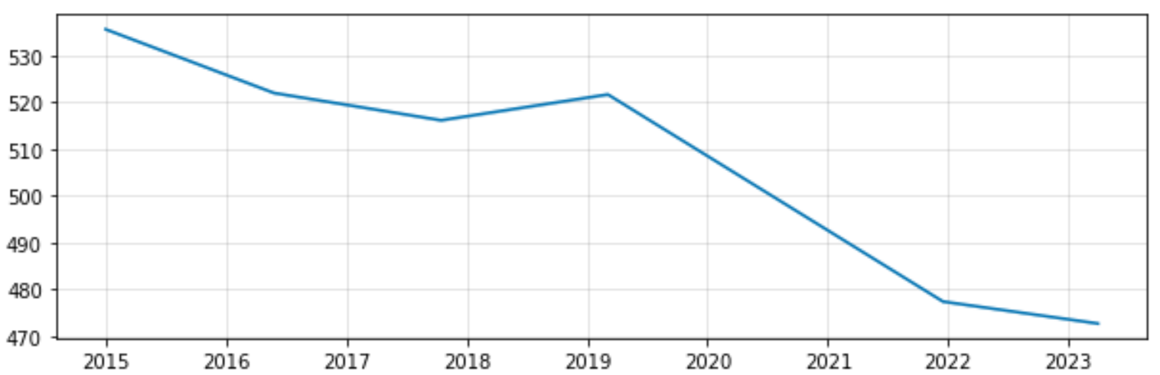
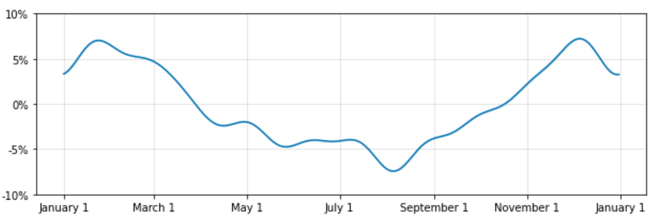
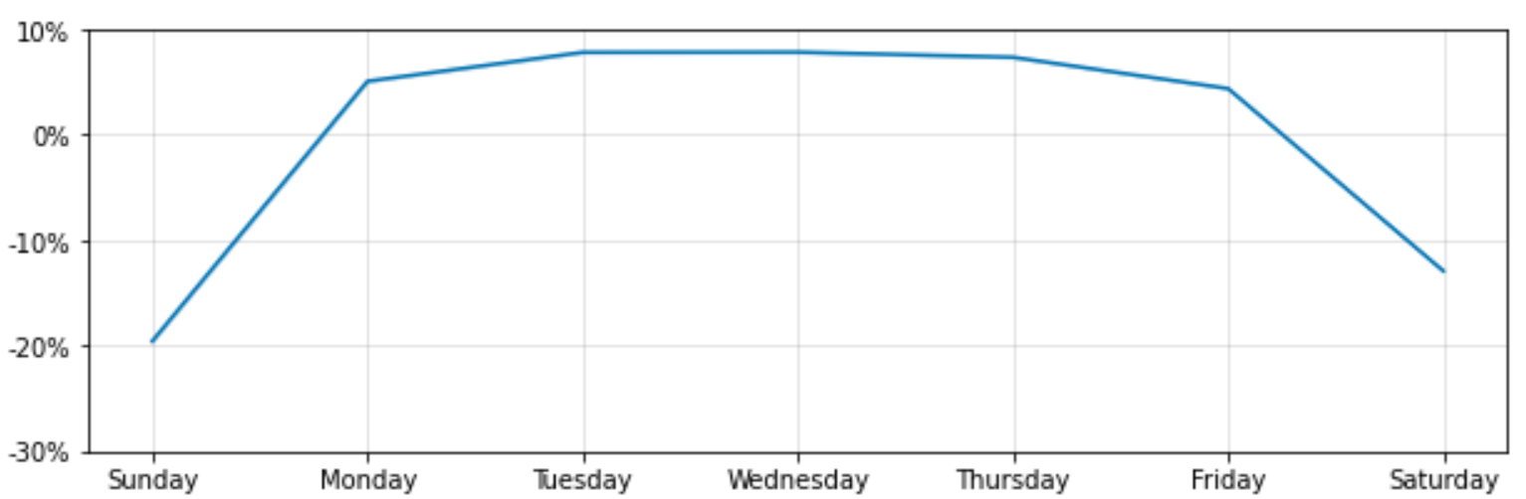
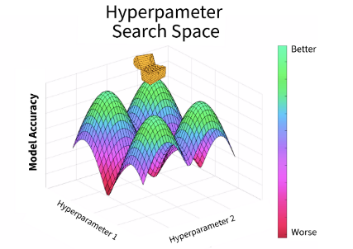
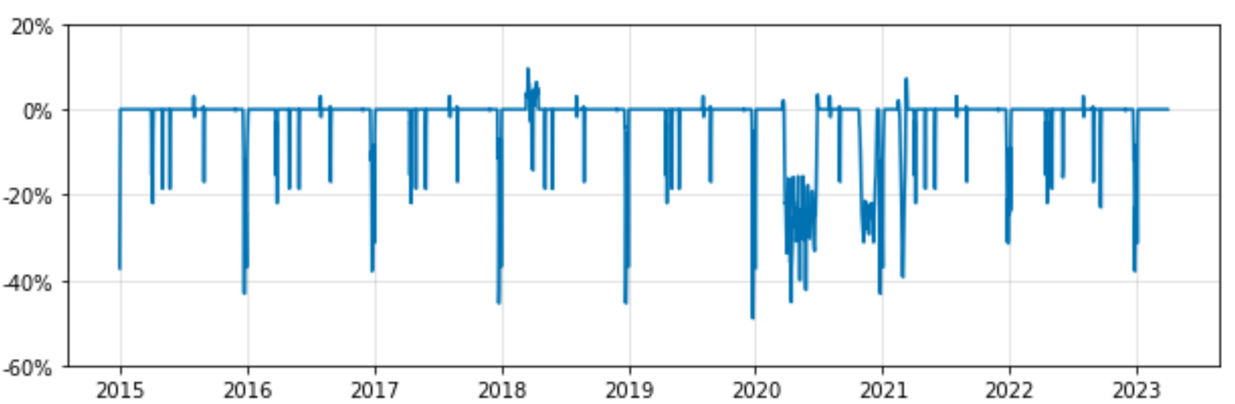
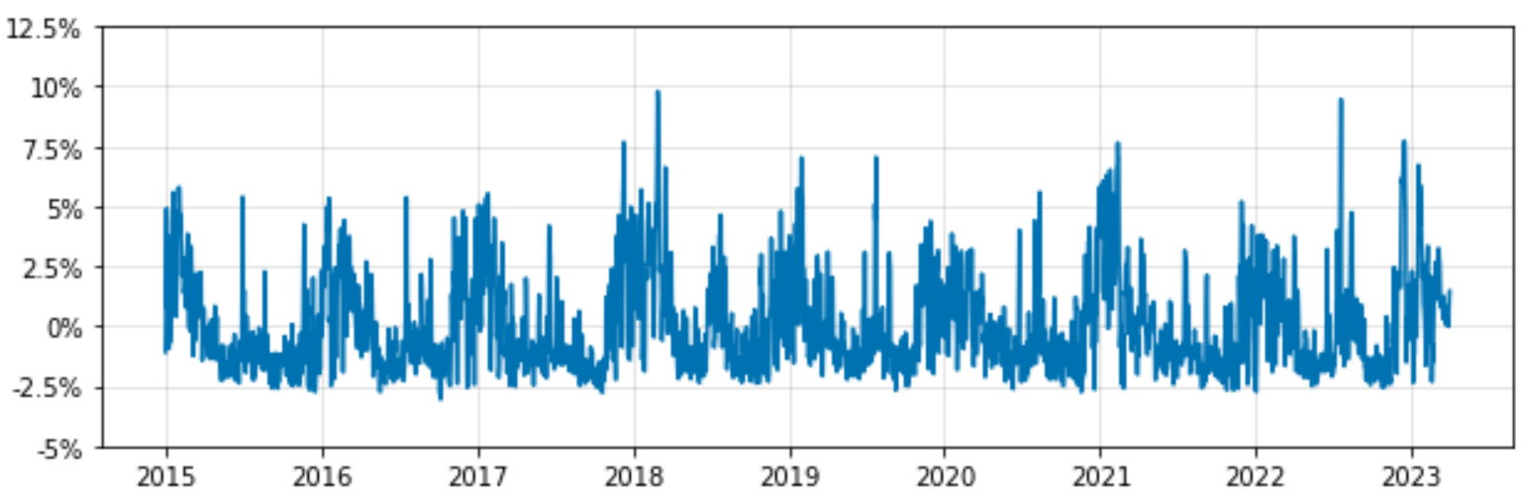
Non-Domestic Daily Model
Signal Breakdown
Trend
Time Series
Signal
Noise [Error]
Yearly Seasonality
Hyper-parameter tuning
Hyperparameters: regularization of Objective Function’s coefficients.
Weekly Seasonality
Holidays
Weather
Regressors
Notes:
14 GSP areas
Domestic/Non-domestic by area.
Understanding the impact of all these Daily // Hourly if you have // variables altogether.
Why does the trend changes quite abruptly on the chagenpoints?
We are using the best variables that are actually clean and are significant.
Therefore, a huge one, which is GDP is out of the picture: adding a “made-up” daily GDP would add noise and be wrong.
Longest Cycle: Year.
So, why only one weekly seasonality along the year?
These are the “out-of-the-box”, default tools that prophet provides to make “fast”, “easy” forecasts.
That’s what Prophet is: various calculations/functions that you will need to be doing all the time to get these “main components”.
These are things that are tackled by adding the needed variables beyond the default.
Holidays:
Each Xmas and NY is going to be different because of the DOW >> beyond default.
Lockdowns added as well.

Slide 7
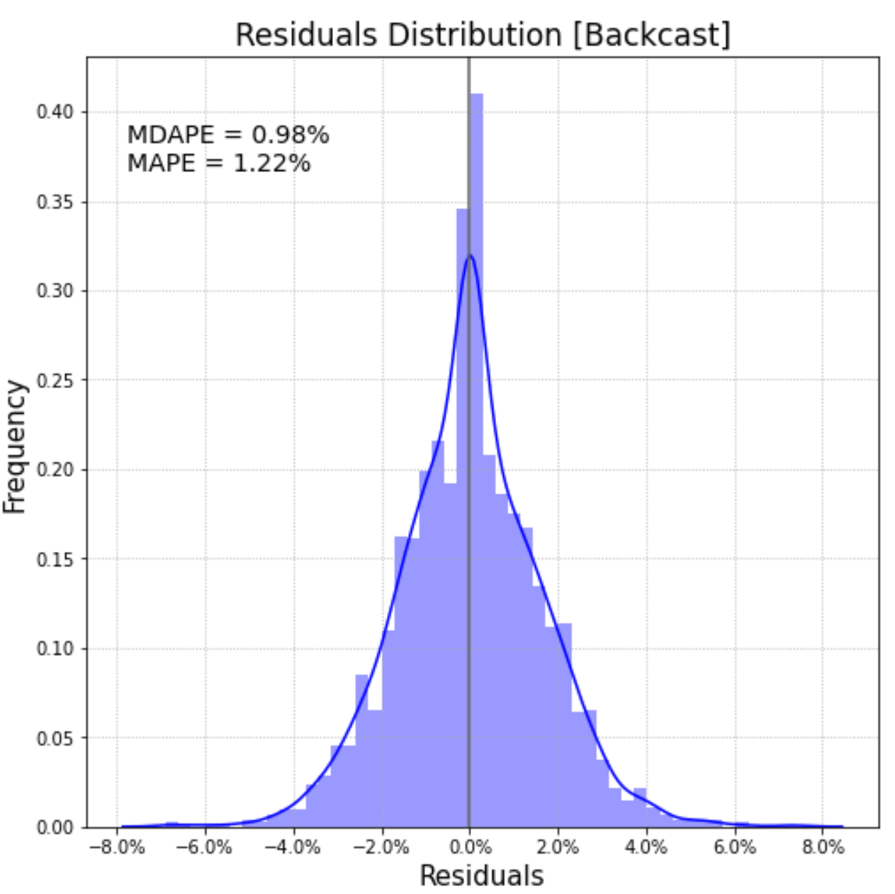
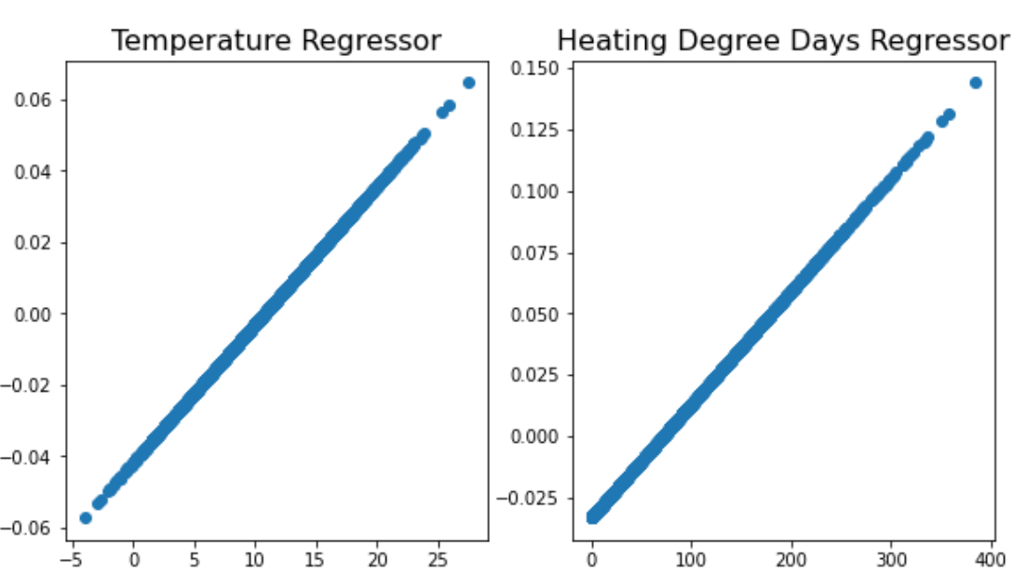
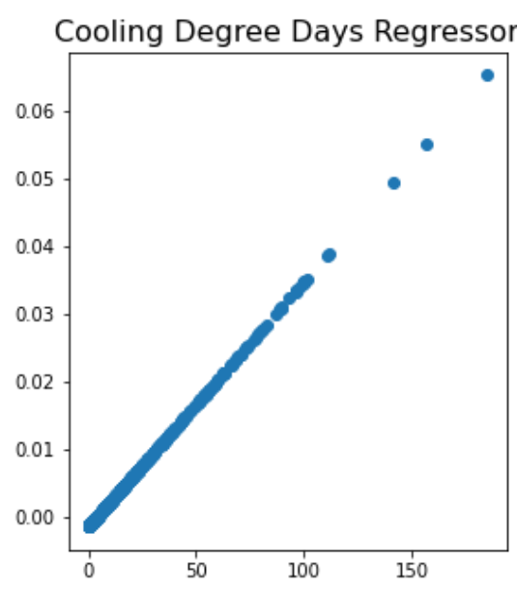
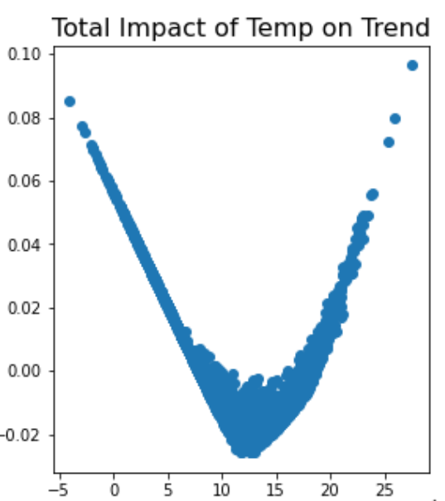
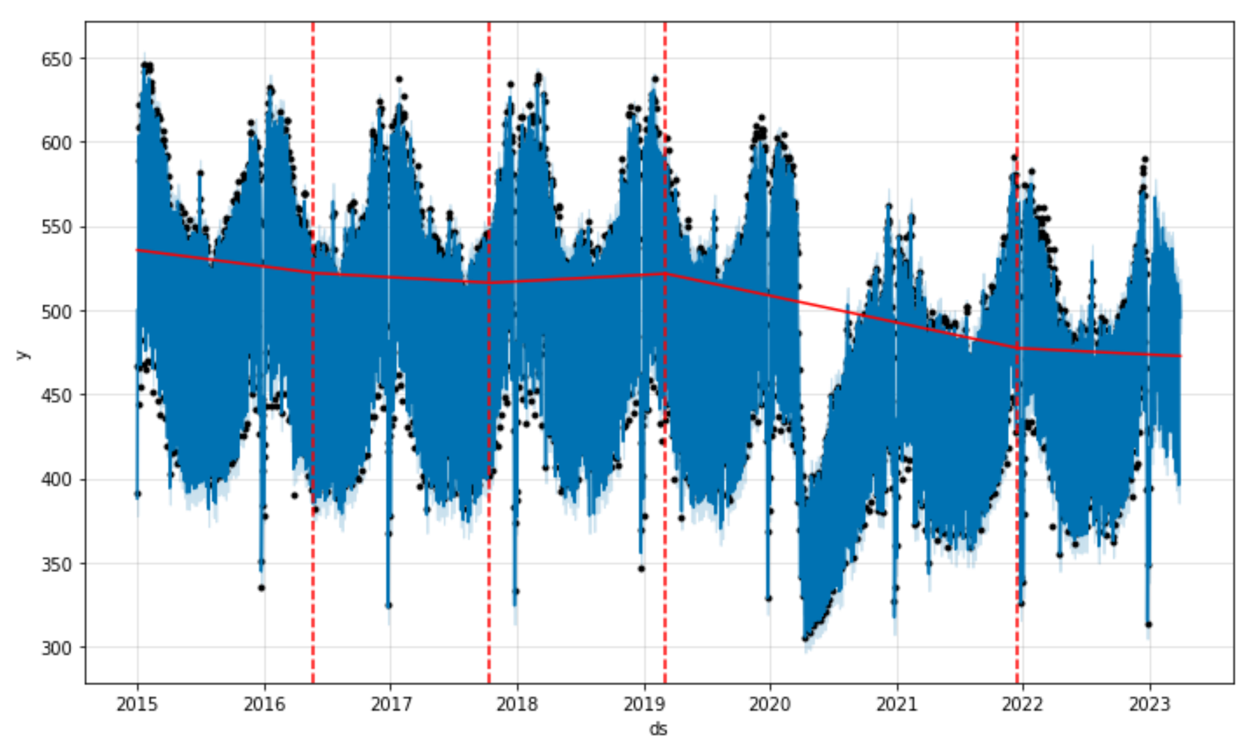
Temperature Regressors
Overcoming linear constraints
Noise [Error]
Forecast + Trend Changepoints
Non-Domestic Daily Model
Time Series
Signal
Noise [Error]
Hyper-parameter tuning
Hyperparameters: regularization of Objective Function’s coefficients.
Notes:
Out of:
14 GSP areas
Domestic/Non-domestic by area.
Regressors are

Slide 8

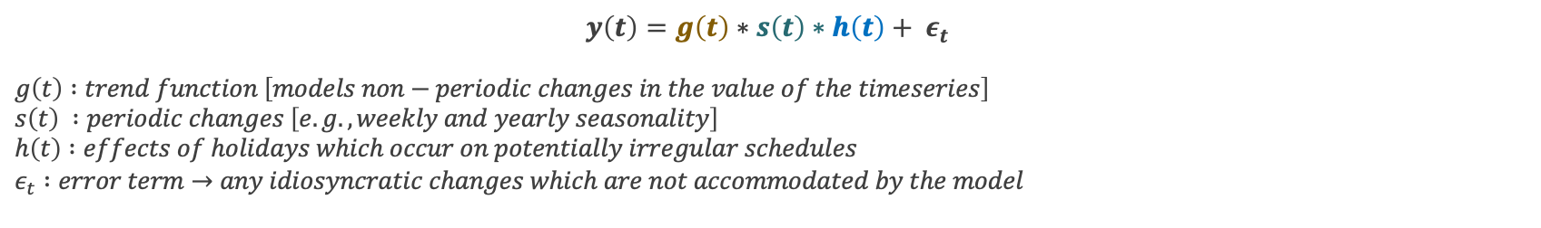

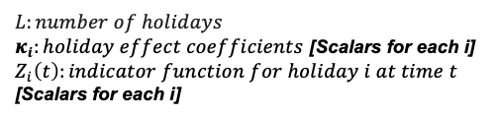
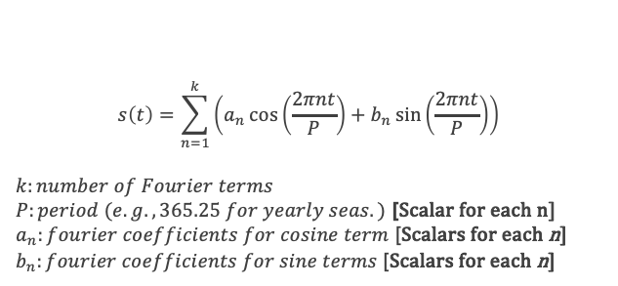

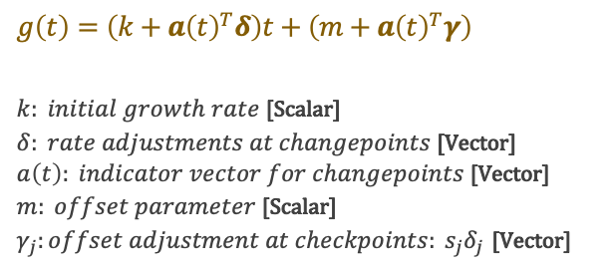
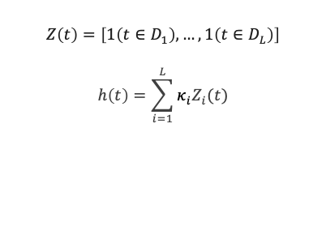
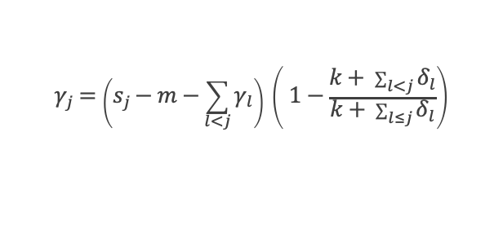

Prophet Objective Function
Forecasting – Decomposable time-series model
Run fourier_series_graphical.py http://127.0.0.1:8050/
Trend Function
Seasonality Function
$$y\left(t\right)=g\left(t\right)∗s\left(t\right)∗h\left(t\right)+ ε_{t}$$
$$g\left(t\right) :trend function \left[models non−periodic changes in the value of the timeseries\right] \\ s\left(t\right) :periodic changes \left[e.g., weekly and yearly seasonality\right] \\ h\left(t\right) :effects of holidays which occur on potentially irregular schedules \\ ε_{t} :error term→any idiosyncratic changes which are not accommodated by the model$$
Holidays
Example: Yearly
Adjustments at changepoints j
$$g\left(t\right)=\left(k+a{\left(t\right)}^{T}δ\right)t+\left(m+a{\left(t\right)}^{T}γ\right)$$
$k: initial growth rate$ [Scalar] $δ: rate adjustments at changepoints$ [Vector] $a\left(t\right): indicator vector for changepoints$ [Vector] $m: offset parameter$ [Scalar] $γ_{j}:offset adjustment at checkpoints: s_{j}δ_{j}$ [Vector]
$$s\left(t\right)=\sum_{n=1}^{k}{\left(a_{n}\cos\left(\frac{2πnt}{P}\right)+b_{n}\sin\left(\frac{2πnt}{P}\right)\right)}$$
$$k:number of Fourier terms$$
$P:period (e.g., 365.25 for yearly seas.)$ [Scalar for each n]
$a_{n}:fourier coefficients for cosine term$ [Scalars for each n]
$b_{n}:fourier coefficients for sine terms$ [Scalars for each n]
$$Z\left(t\right)=\left[1\left(t∈D_{1}\right),…, 1\left(t∈D_{L}\right)\right]$$
$$h\left(t\right)=\sum_{i=1}^{L}{κ_{i}Z_{i}(t)}$$
$$h\left(t\right)=z\left(t\right)κ$$
$$L:number of holidays$$
$κ_{i}:holiday effect coefficients$ [Scalars for each i]
$Z_{i}\left(t\right):indicator function for holiday i at time t$ [Scalars for each i]
$$X\left(t\right)=\left[\cos\left(\frac{2π\left(1\right)t}{365.25}\right),…,\sin\left(\frac{2π\left(10\right)t}{365.25}\right)\right]$$
$$γ_{j}=\left(s_{j}−m−\sum_{l<j}{γ_{l}}\right) \left( 1−\frac{k+ \sum_{l<j}{δ_{l}}}{k+ \sum_{l≤j}{δ_{l}}}\right)$$
$$β={\left[a_{1},b_{1},…, a_{N},b_{N}\right]}^{k}$$
Same concept for the included regressors.
$$s\left(t\right)=X\left(t\right) β$$
Notes:
SHOWING:
The MODEL PARAMETERS, which are the coefficients of the different functions within the objective functions.
Delta (rate of adjustments at changepoints) is a double_exponential so many changes are close to 0, promoting a smooth trend with occasional abrupt changes.
Fourier Series Premise: Given an infinite number of different cosines and sines we can approximate that function to any function.
So, in Prophet the seasonality model is learning a weight for each of the different frequency cos/sin & summing them up together.
a(t):
a_t is a binary vector where each element indicates whether time t is after the corresponding changepoint.
- For example, if there are changepoints at times t_1 and t_2 , then:
a_t = [I(t > t_1), I(t > t_2)]
where I is an indicator function that returns 1 if the condition is true and 0 otherwise.

Slide 9
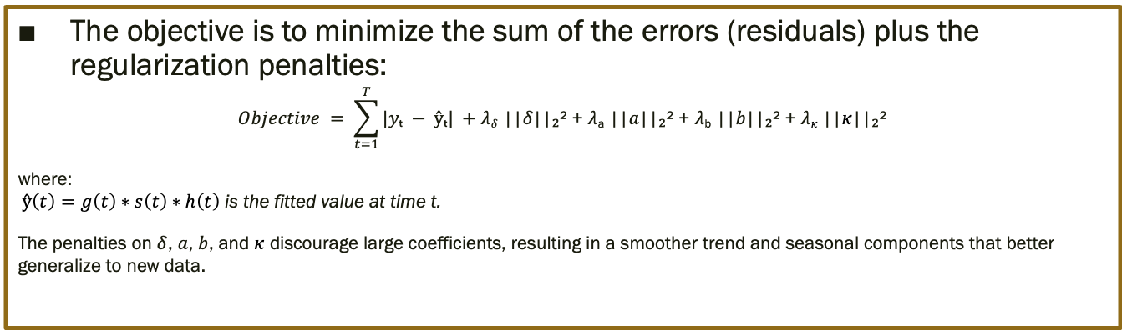
Prophet Objective Function
Forecasting – Decomposable time-series model
$$y\left(t\right)=g\left(t\right)∗s\left(t\right)∗h\left(t\right)+ ε_{t}$$
$$g\left(t\right) :trend function \left[models non−periodic changes in the value of the timeseries\right] \\ s\left(t\right) :periodic changes \left[e.g., weekly and yearly seasonality\right] \\ h\left(t\right) :effects of holidays which occur on potentially irregular schedules \\ ε_{t} :error term→any idiosyncratic changes which are not accommodated by the model$$
Regularization + Objective Function in classic ML…
The objective is to minimize the sum of the errors (residuals) plus the regularization penalties:
$$Objective = \sum_{t=1}^{T}{|yₜ − ŷₜ|} +\text{λ}\text{δ}\text{ ||}\text{δ}\text{||₂² + }\text{λ}\text{a}\text{ ||}a\text{||₂² + }\text{λ}\text{b}\text{ ||}b\text{||₂² + }\text{λ}κ\text{ ||}κ\text{||₂²}$$
where: $ŷ\left(t\right)=g\left(t\right)∗s\left(t\right)∗h\left(t\right)$ is the fitted value at time t.
The penalties on $δ$, $a$, $b$, and $κ$ discourage large coefficients, resulting in a smoother trend and seasonal components that better generalize to new data.
Equivalent:
L1 loss function for more robustness to outliers because it penalizes them linearly.
L2 (Ridge Regression) penalizes the hyperparameters quadratically.
Notes:
TABLE 1:
The MODEL PARAMETERS, which are the coefficients of the different functions within the objective functions.
Delta (rate of adjustments at changepoints) is a double_exponential so many changes are close to 0, promoting a smooth trend with occasional abrupt changes.
Fourier Series Premise: Given an infinite number of different cosines and sines we can approximate that function to any function.
So, in Prophet the seasonality model is learning a weight for each of the different frequency cos/sin & summing them up together.
TABLE 2:
The MODEL HYPERPARAMETERS, which affect the model parameters quadratically to make them smoother > Regularization L2 here.
To explain the L2 in minimizing the objective function:
The functions is minimizing the ERRORS, which depend on different values for each variable.
However, the L2 affects all variables in the same way, it makes them be lower.
Therefore, it ends up smoothing and making these coefficients sensible numbers, not super large.

Slide 10
Bayesian probabilities Refreshing memory
Represents a degree of belief or uncertainty about an event, updated as new evidence becomes available.
“Probabilities” (beliefs) change as you learn more.
You need to input “prior” beliefs and data (residuals/errors follow a normal distribution).
Make sense in time-series forecasting because:
They allow for updating predictions as new data arrives.
Bayesian models provide uncertainty estimates for future values.
Handle non-stationarity.
Incorporate prior knowledge (such as past patterns or domain expertise).
Notes:
Uncertainty estimation in Forecasts.
The uncertainty estimation of the future depend on the delta component (trend changes). Assuming trend changes’ frequency and size remain the same.

Slide 11
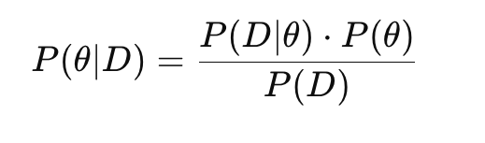
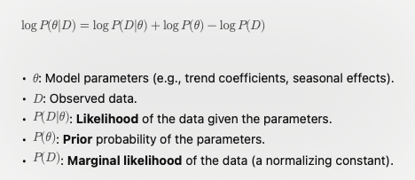
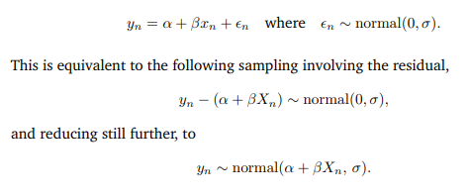
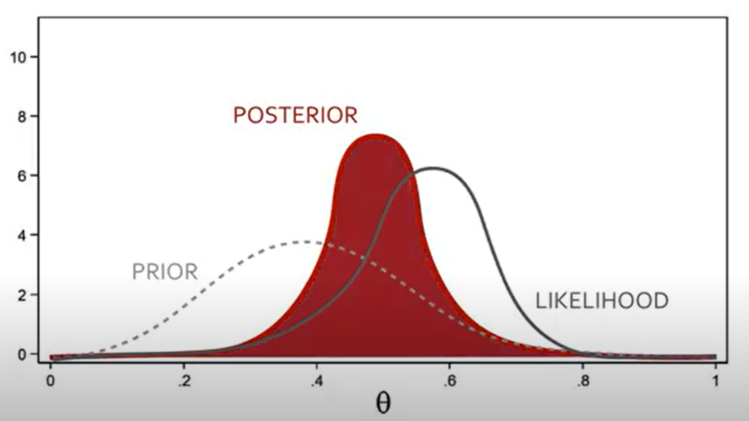
Model Fitting, Posterior Distribution
Most calculations use Bayesian inference.
Note: We clearly want the residuals to follow a normal distribution → We might as well input and use that information.
Posterior Log-likelihood is used in:
Optimization for MAP Estimation.
MCMC Sampling for Posterior Distribution.
The errors/residuals of y are normally distributed. That’s our first assumption (“prior distribution”).
Posterior log-likelihood
Formulating a linear regression for Bayesian Inference
Notes:
Posterior Log-Likelihood == Logarithm of the posterior probability.
Combines:
How well the model fits the data (likelihood). |. Likelihood (fitting)
Prior beliefs about the parameters (priors). [hyperparams]
>>>> Without our prior, things would be fitted under NOT the assumption of (errors ~ normal_distribution with a mean of 0 )
>>>> Wouldn’t ensure stationarity, wouldn’t ensure errors’ mean ~ 0.
Linear regression using L-BFGS:
Mathematical input into STAN.
STAN: Bayesian inference software.
Widely used, conference this month at the University of Oxford.
Meta (Facebook) uses it clearly.

Slide 12
Graph of the steps taken by Prophet + HP...
Hyper-parameters tuning:
Inputs:
Search space.
Distribution.
Max iterations.
Tree-based probabilistic optimization.
Data Processing
Model Creation
Model Fitting
Model Scoring
Final Model
Specify all parameters/variables of the model.
Hyper- parameters’ Optimization
Including all parameters from the best fitted model.
When forecasting: Uncertainty samples for forecast’s intervals.
MCMC/MAP: Bayesian Inference | Optimization | Sampling (w/ regularization).
Output: Model with parameters’ coefficients, etc.
Iterative historic forecast testing.
Notes:
Regularization = Priors.

Slide 13

GB daily model
Example

Slide 14
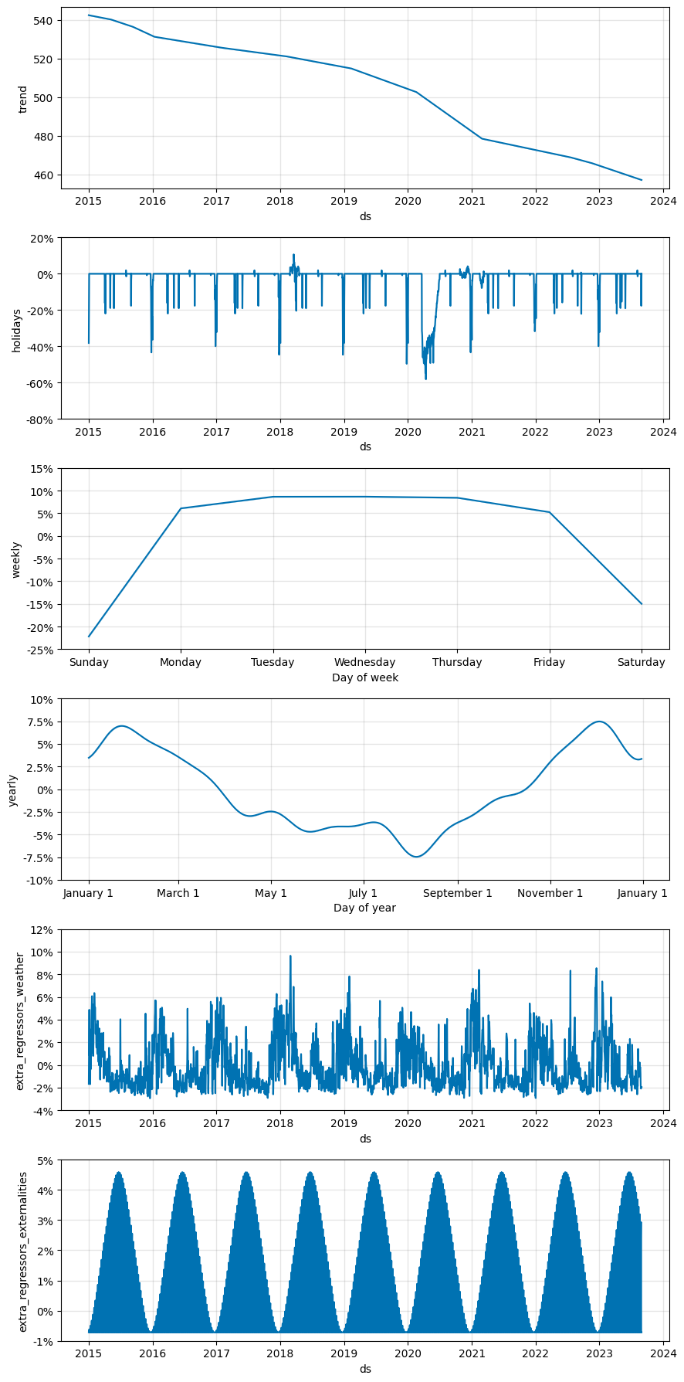
Main Components
Trend, Holidays, Weekly Seasonality
Ad-hoc implementations:
Holidays including day-of-week sensitivity.
Weekdays yearly-changes (by daylight seconds).
Lockdowns’ impact using ”holidays”.
Yearly Seasonality, Weather reg., Weekends reg.
Notes:
The lag-dependencies from an ARIMA model are ”captured” by components: trend, yearly Fourier series.

Slide 15
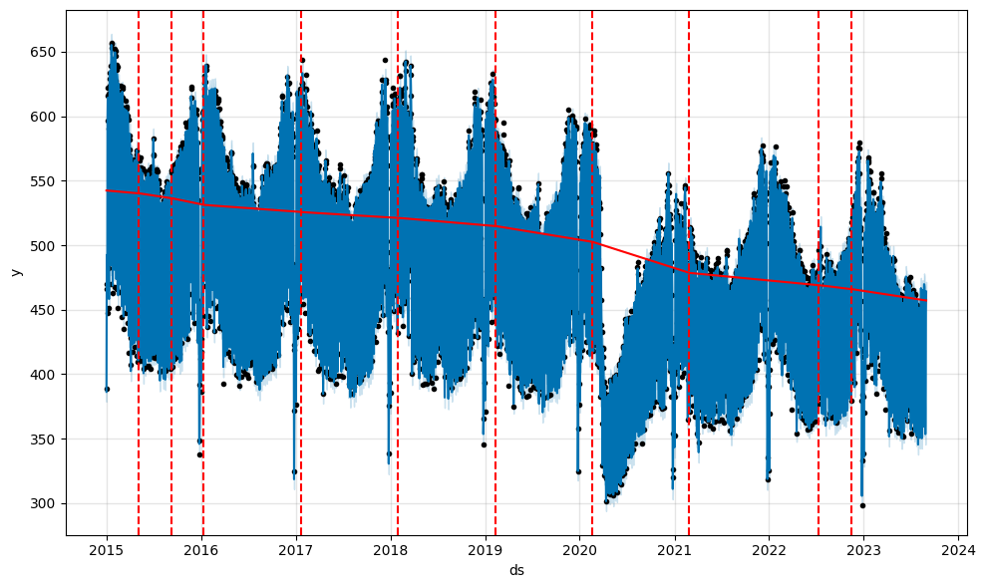
Back-cast and Forecast

Slide 16
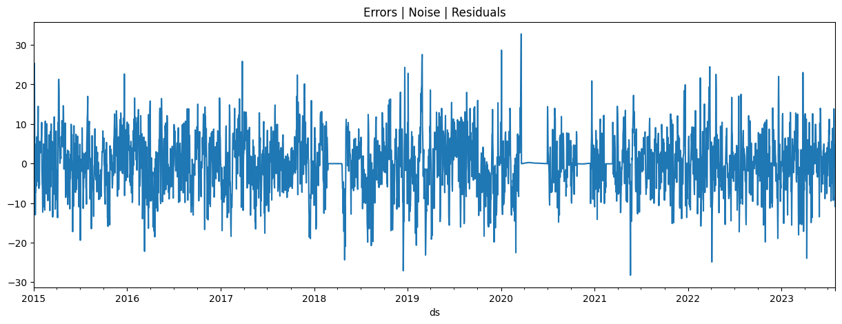
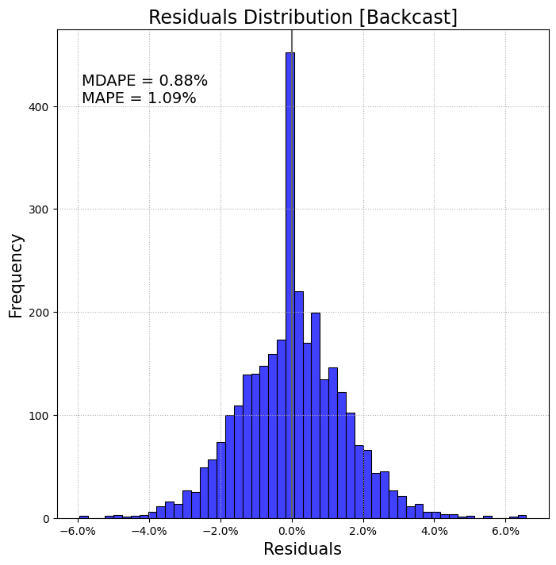
Noise, Error, Residuals from back-casting
By looking at the overall model’s residuals it seems quite stationary → What about by component?
Optimization starts by setting the residual as a normally distributed around 0.

Slide 17
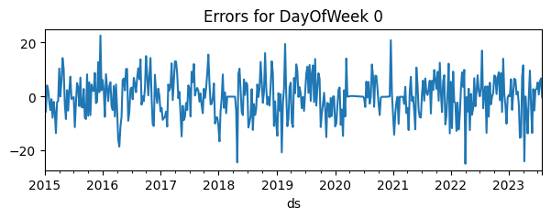
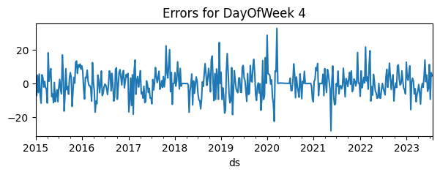
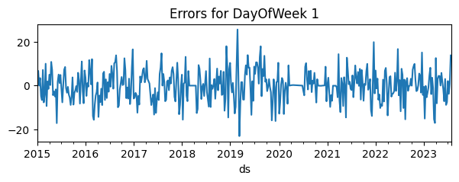
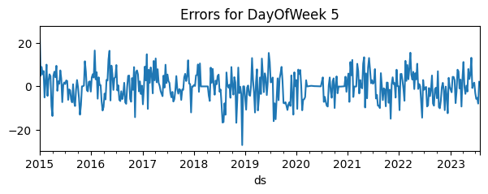
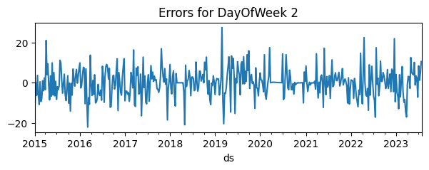
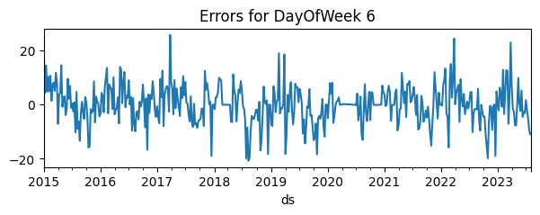
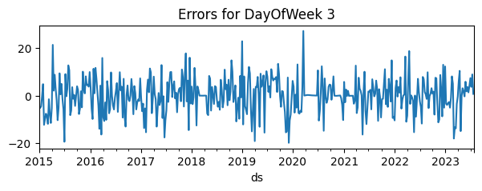
Noise by Day of Week
Example by graphs of how explainable signals not captured by the model can be mathematically captured by refining the model:
We can see some days of the week are less stationary.
Before adding the “daylight_hours” regressor for the weekends → noise was even more seasonal.

Slide 18
GB monthly model
Example

Slide 19
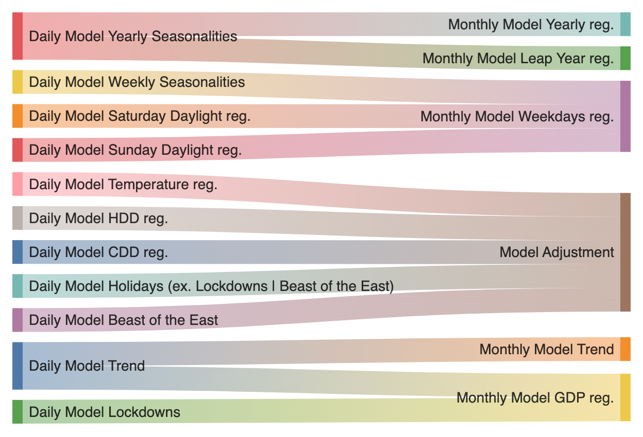
Into Monthly Modelling
What we are taking out (adjusting) from the Daily Model are all the variables that are not being caught by the Monthly Model.

Slide 20
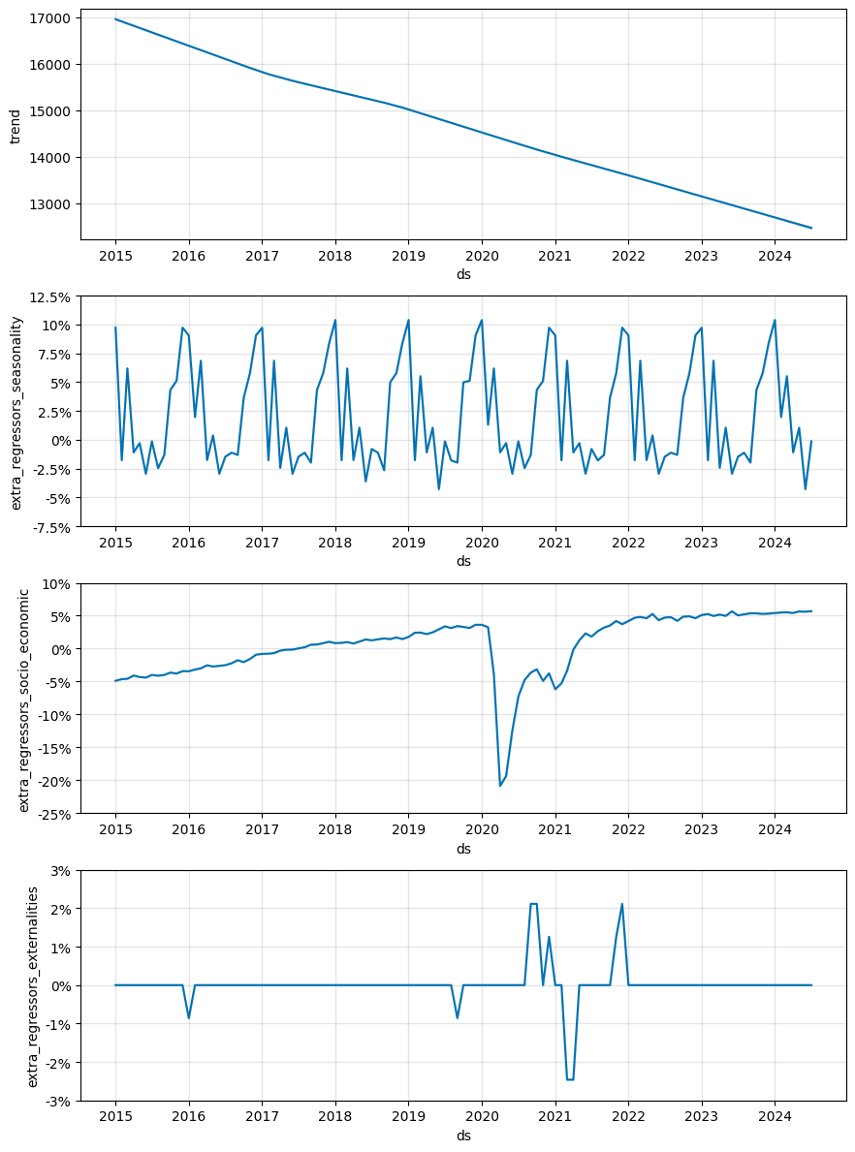
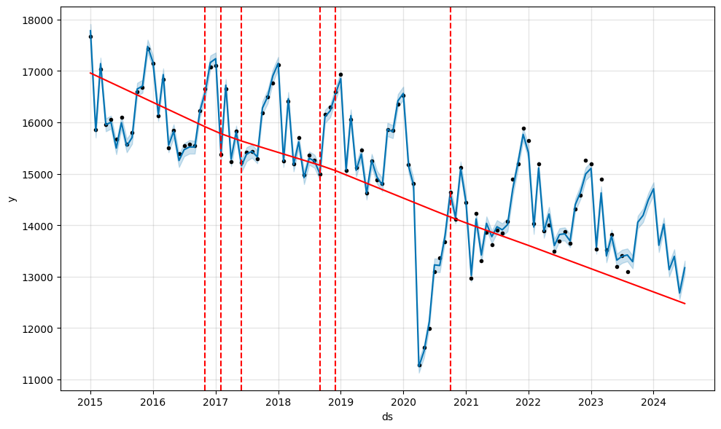
Main Components using weather/holidays-corrected demand...
Trend, Seasonality+, GDP, anomalies
Left graph:
Seasonality accounts for: leap years, number of weekdays.
Forecast, changepoints, uncertainty-intervals
Notes:
GDP is super correlated in GB-non-domestic Demand because of the huge COVID drop.
Otherwise the seasonality of the year kinda takes lots of the signals in, therefore:
In some scenarios it might be better having 2 different variables for GDP:
GDP trend.
Yearly GDP seasonality.

Slide 21
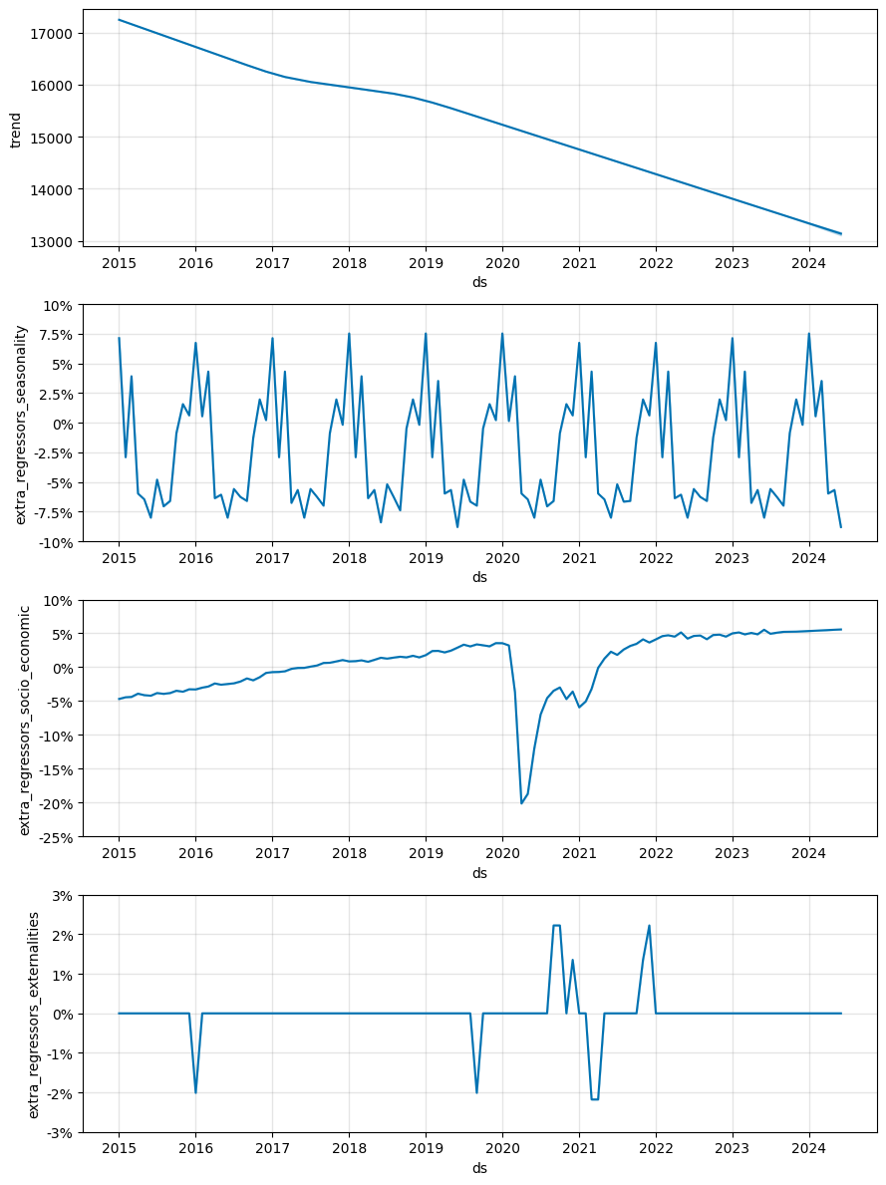
Some thoughts
Trend, Seasonality+, GDP, anomalies
Interpreting:
Trend: Without GDP as a regressor, the trend would require more changepoints and show a less pronounced downward slope, as time would be absorbing the signals typically explained by GDP.
Trend: Therefore, in this model, the trend represents everything not captured by the other model variables, such as:
Efficiency improvements across GB,
The decarbonization of the GB economy,
Increased adoption of electric vehicles (EVs) and heat pumps,
Behind-the-meter generation, and more.
Thoughts: This model makes creating different GDP scenarios straightforward, allowing for easy decomposition into granular model timesteps under various weather conditions.

Slide 22
Scenarios
Example

